Slide 1
Fridge Magnets
Tourism, Data Collections, some of my favorite things

Slide 2
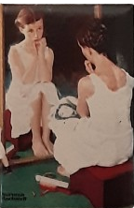
Start
In 1991, went to Norman Rockwell Museum in Stockbridge, MA and bought a magnet. It was a cheap memorable way to remember a tourism site.
Now, 30+ years later, there are 463+ in our collection.

Slide 3
Magnets in the collection
477*
* As of November 2023, this is an active growing collection

Slide 4
Over time, different collections
324 Trip Souvenir
52 Advertising Magnets
36 Gift or Inherited
34 Event Souvenir
31 Unknown

Slide 5
And, got bored
During the pandemic lockdowns of 2020, I decided to inventory what I had.
Took pictures, uploaded to Airtable database and created a rudimentary database.
Continued to buy and document magnets
In Summer of 2023, cleaned up the database, and added more characteristics during annual cleaning.

Slide 6
Analysis - how did I do it
Download to excel
Cleaned data checking columns, descriptions, and other items
Merged some columns with redundant information
Used excel functions, pivot tables, filters, and graphs for data
Used google for location milage, Removebg to cleanup pictures, powerpoint for presentation

Slide 7
Magnet Demographics!

Slide 8
Shape!
356 Rectangles
2 Triangles
45 Squares
60 Round Circles
13 Ovals

Slide 9

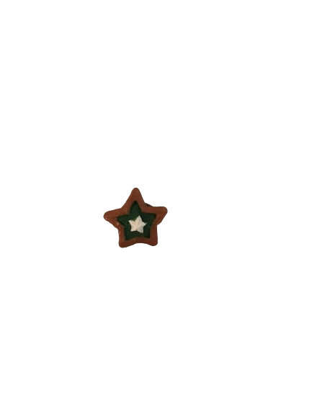
By Area, Largest and Smallest
4 high by 6 inches wide, 75.36 square inches Total.
7/8 inch high by 7/8 inch wide, .61 square inches

Slide 10
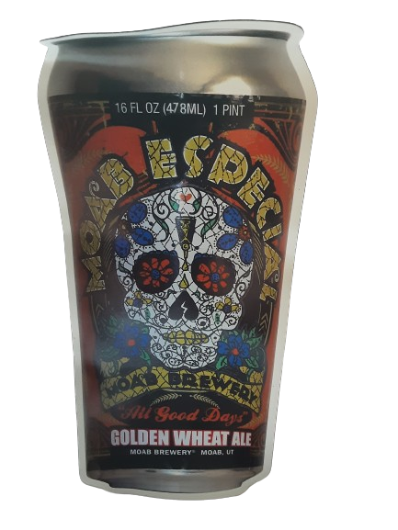
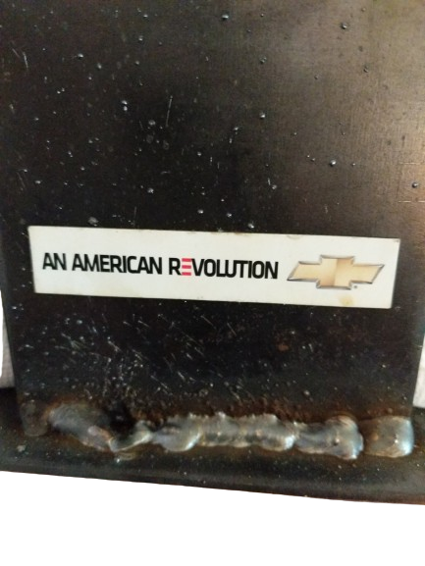
Tall and short
7.5 inches high – same as the actual beer can
2/3 inch tall

Slide 11
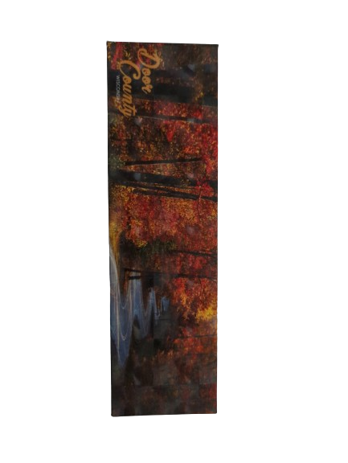
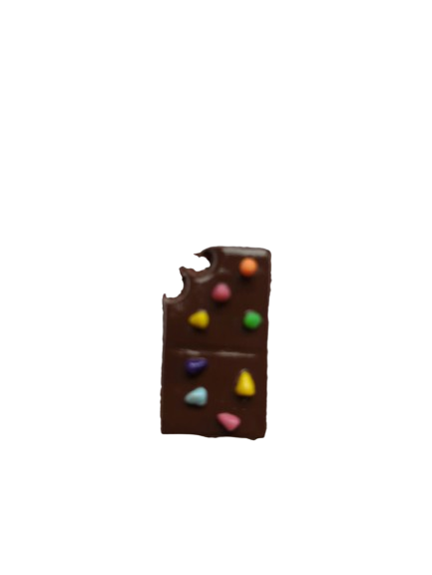
Wide and skinny
6 2/3 vs 2/3 inch wide
2/3 inch wide

Slide 12
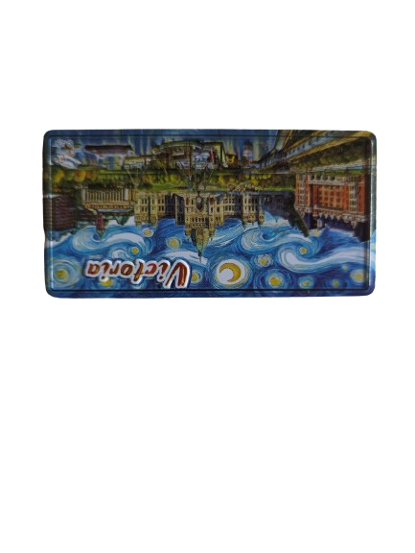
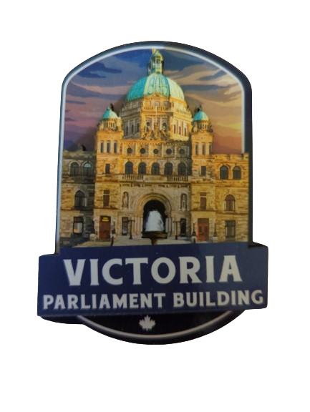
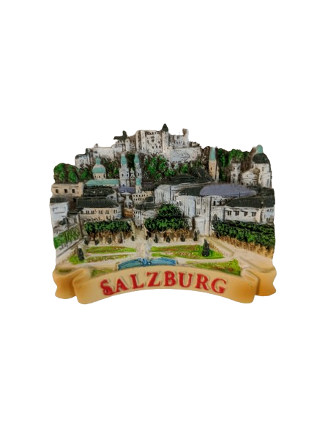

Miles
Furthest overall – 4,555 miles
That I bought – 2,170 miles (2 magnets)
Closest – 1 mile
Average 651 miles

Slide 13
Five Countries
Top States
WI 143
IL 47
UT 31
MA 21
IA 18
TN 17

Slide 14
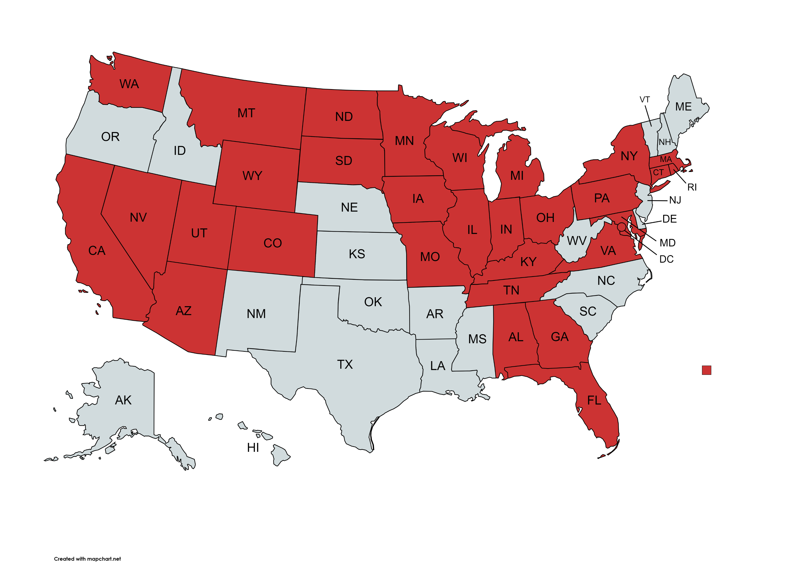
31 down, 20 to go

Slide 15
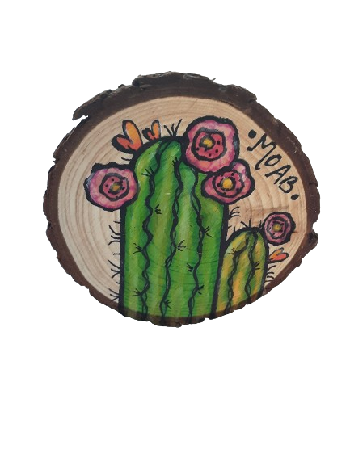
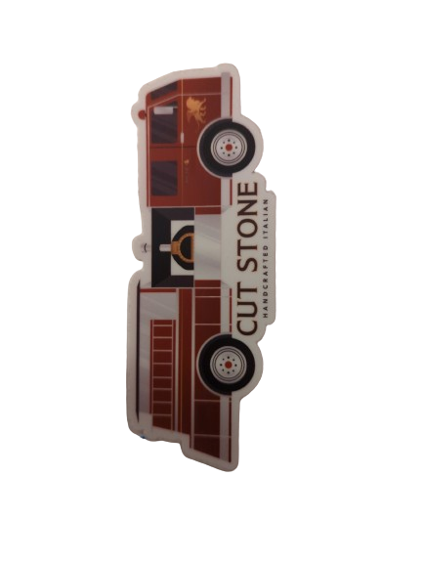
Money
Most Expensive $20
Cheapest $1

Slide 16
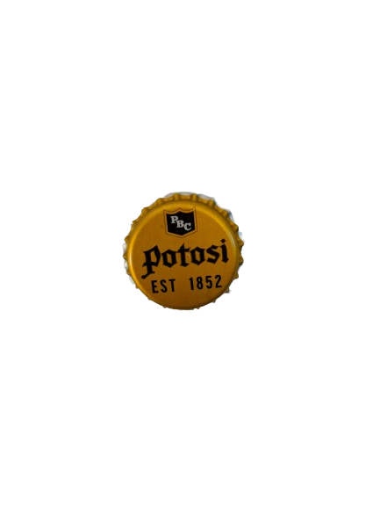
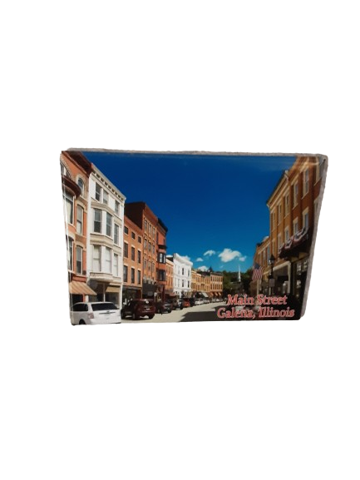
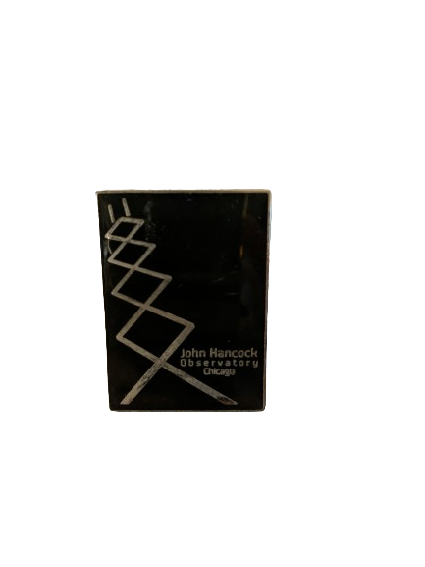
Duplicates
We get asked about duplicates – identical magnets. We have three pairs where we bought the same magnet from the same place twice, at different times.
Potosi and Galena from separate trips in 2016 and 2020. John Hancock Observatory could have been from any trip to Chicago since 1997

Slide 17
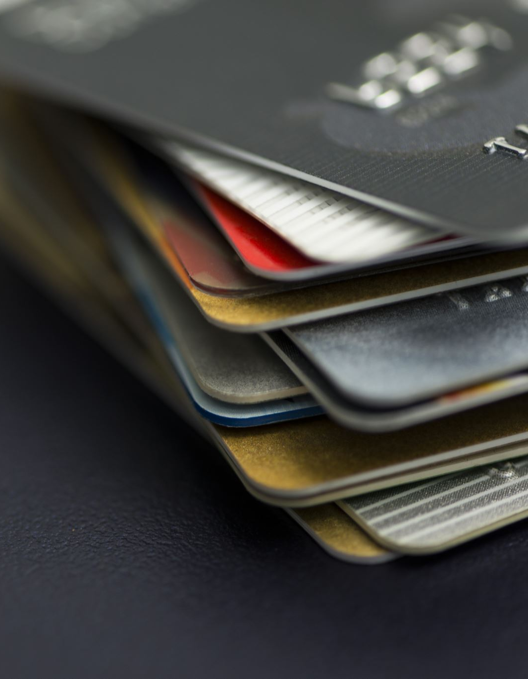
Total - $802.86
About half of the magnets still had a price tag, if it was legible, it was added to the record.
For the rest, if it was a gift or business freebie, the price was .01. Magnets that were purchased but without a price tag, I assigned an artificial price of .02
These were not included in the analysis or totals.

Slide 18
Material – and Art Type
Tracked 17 different materials including ceramic, wood, paper, fabric, polymer plastic, resin plastic, and metals.
Art Types range from Modern photos to State Shape to Retro and beyond. Some magnets had multiple art types

Slide 19

Example
Material
Metal
Art Type
Retro
Embossed metal with color inlays
Characteristic
Part that moves
(bus goes back and forth)

Slide 20
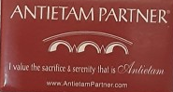
Most Popular Material
13 categories of materials had 25 or less magnets – they included paper with heavy acrylic, ceramic, wood with paper, sticker with a magnet on back, 3-D resin molded, wood painting, flat flexible polymer plastic, wood-engraved, felt, 3-D polymer plastic, mixed materials, glass, and natural stone

Slide 21
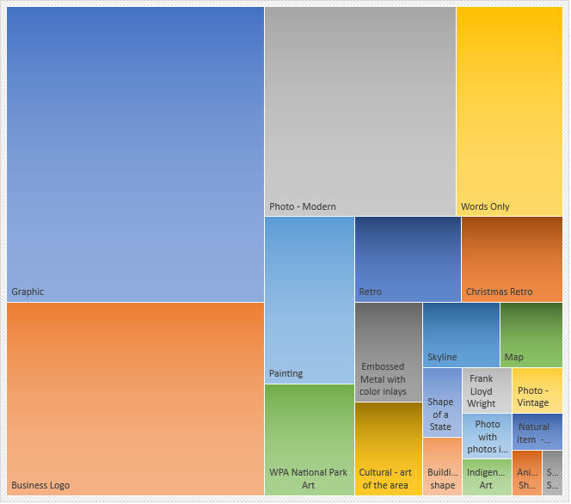
Art Type – Most magnets have more than one type

Slide 22
And some have characteristics
3-D Magnet | 86
Cutout | 19
Bottle Opener | 9
Part that moves | 6

Slide 23
Top Types
Material | Art Type | Total
Paper-Stiff back, thin acrylic, not flexible | Photo-Modern | 62
Paper-stiff back, thin acrylic, not flexible | Graphic | 45
Paper – flexible back, thin acrylic | Words Only | 38
Paper – flexible back, thin acrylic | Graphic | 26
Paper – flexible back, thin acrylic | Business logo | 25

Slide 24

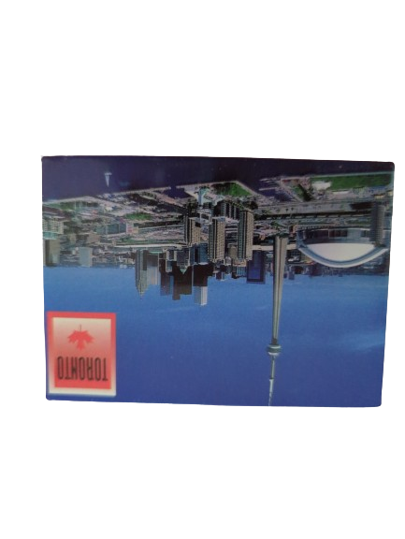
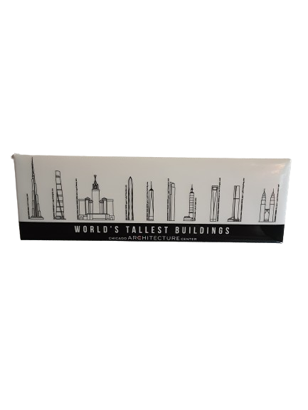
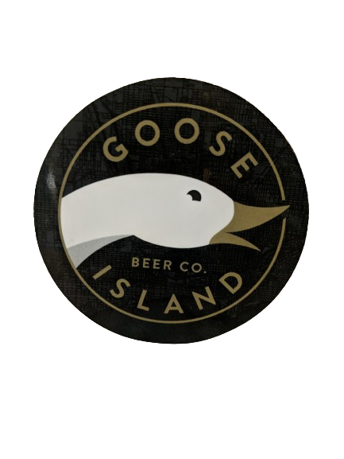
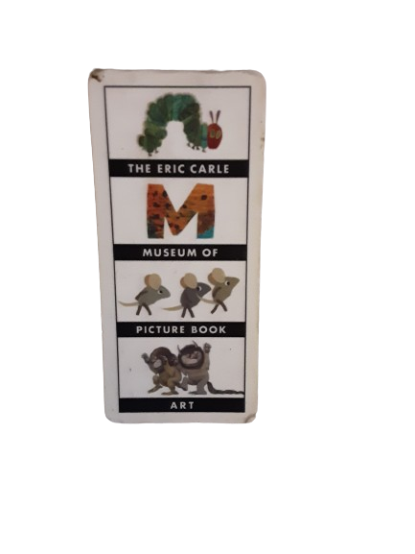
Examples of Top Five
City of Toronto
Tallest Buildings
IMU Connect
Eric Carle Museum
Goose Island Beer

Slide 25
How many magnets I bought each year
If you look carefully, 232 (49%) magnets are not included on the chart because I don’t remember when they were purchased. Given their condition, it is possible most date from 1992 to about 2010

Slide 26
So, where did we buy (or get) them?

Slide 27
Some analysis
Question – has the price of magnets gone up over the years?
Method – Filtered for magnets with both a price tag and a definite date. There were 134 magnets that met both criteria (28%). I then used the chart function to plot the data.

Slide 28
This chart plotted the 134 by price and year With one significant outlier, most of the magnets were under $10. So, I checked the average cost per year

Slide 29
Average Results
The Average cost stayed under $10, most were between $3 and $6.
The older the magnet was, the less likely it had a price tag. Almost all of the 2021 on had tags, before 2000, only a couple

Slide 30
Limitations
Only magnets with a year and a price tag were included. For magnets without a tag, or we couldn’t identify a year were omitted. Those magnets may have been significantly more or less expensive.

Slide 31
The End?
Our goal is 1,000 magnets

